Slide 1


SUBJECT
INTRODUCTION TO DATABASE (2108)
SECTION
X
GROUP
INTRODUCTION TO DATABASE (2108)
PROJECT ON
INTRODUCTION TO DATABASE (2108)

Slide 2

Project title: Criminal Face Detection System
GROUP MEMBERS
SHAHADAT HOSSAIN [23-51341-1]
AKIB HASAN PYIL [23-50531-1]
NAZAT E ROSE RHYTHM [23-50559-1]
MOST. SUMAIYA HABIBA NISHAT [23-50515-1]
SANIA AKTER [23-50511-1]

Slide 3
Introduction
01
Q- What is the main aim of the project?
A- Enhancing global security using image recognition technology.
02
Q- How does this project contribute to the tech sector?
A- By automating and enhancing efficiency of security checks.
03
Q- What is the practical application of this project?
A- Automated background checks at security gates using facial images.
04
Q- Who are the primary target consumers of this project?
A-Security forces worldwide for efficient criminal record checks.
05
Q- Who could be the potential secondary target consumers?
A- Financial and educational institutions for enhanced security and fraud prevention.

Slide 4
Case Study / Scenario
CASE STUDY 1:
In a world where crime rate is at an all-time high, to maximize securities and key checkpoints, a face detection system has been applied that will scan the faces of individuals and check database to see if they have a criminal past or not. At first, A person goes through an image detection, the person has Name, Gender, a unique ID, Age and Address that will contain information about House number and Street name. Image Detection will store a unique Image ID, a date of when it was scanned, and timestamp, as well as the location. Image Detection will detect if the person is a Suspect and has Criminal Record. Criminal Record will have a unique criminal ID and description. Suspect will have Suspect ID, Age and Name, Gender, and address that will contain House and Street. A Suspect with a Criminal record will be linked with a Crime, there are three types of crime, Robbery, Assault and Murder. A crime will have a Crime Scene. Crime scene will have a unique Case ID, Description, Evidence, and location. On the other hand, Image Detection will search the Server which will host the Criminal Database and will have a Cloud Address. A Surveillance Camera, which will have a unique Cam Id and image and video attributes, will record the Crime Scene and upload it to the server. Once the image Detection detects a criminal past, it will inform the law enforcement, law enforcement will have badge No., Contact information, Name, Rank and Department and they will handle the Crime Scene.

Slide 5
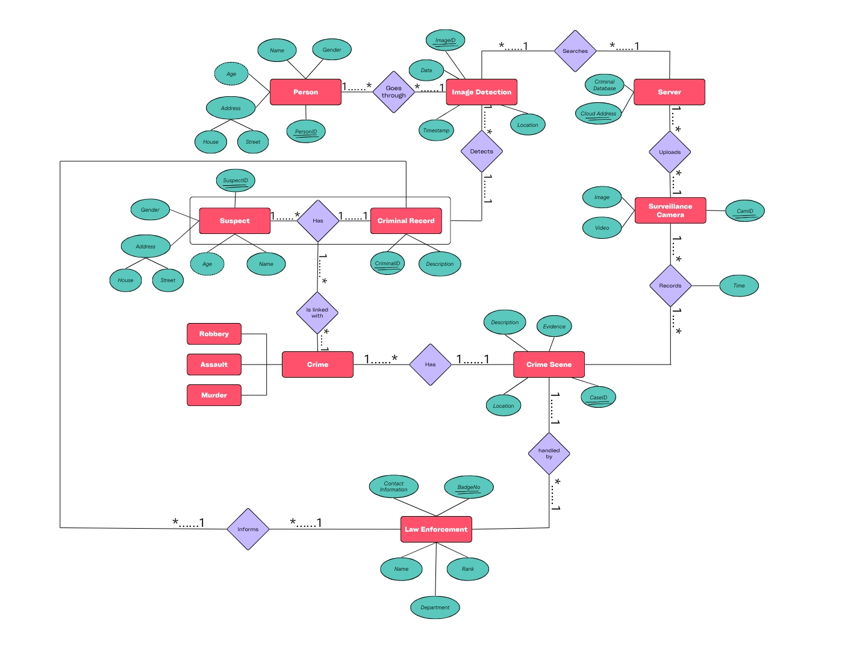
ER DIAGRAM

Slide 6
Finalization
1. PersonID(pk), Name, Age, Gender, Street, ImageID(fk)
2. ImageID(pk), Date, Timestamp, Location, cloud Address(fk), CriminalID(fk), SuspectID(fk)
3. Cloud Address(pk), Criminal Database
4. SuspectID(pk), Name, Age, Gender, Street, CriminalID(fk),
5. CamID(pk), Image, Video, Cloud Address (fk), CaseID(fk)
6. CaseID(pk), Location, Description, Evidence, BadgeNO(fk)
7. CriminalID(pk), Description, BadgeNO(fk)
8. BadgeNO(pk), Name, Rank, Contact Info, Department

Slide 7

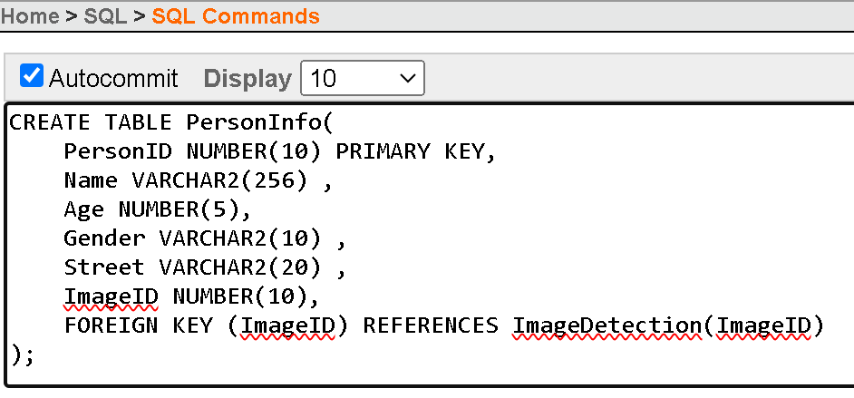
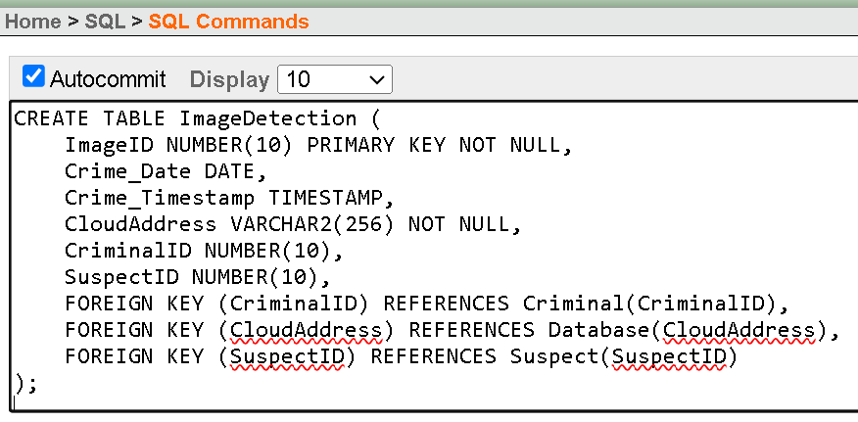
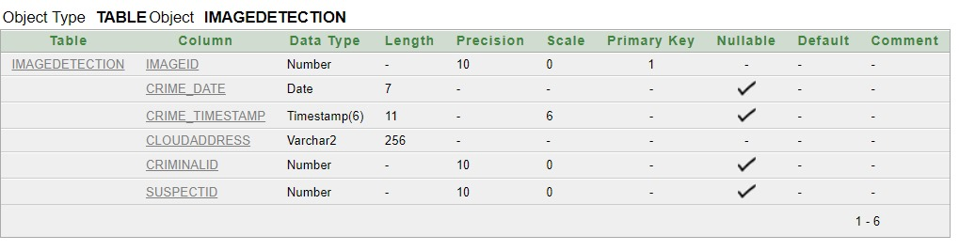
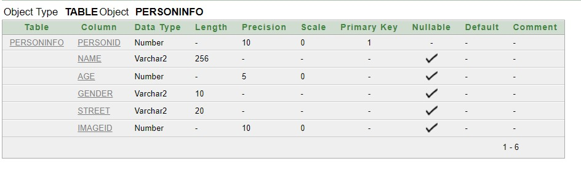
Table Creation (DDL Operations)
Table-1
TABLE 2:
DESCRIPTION:
DESCRIPTION:

Slide 8
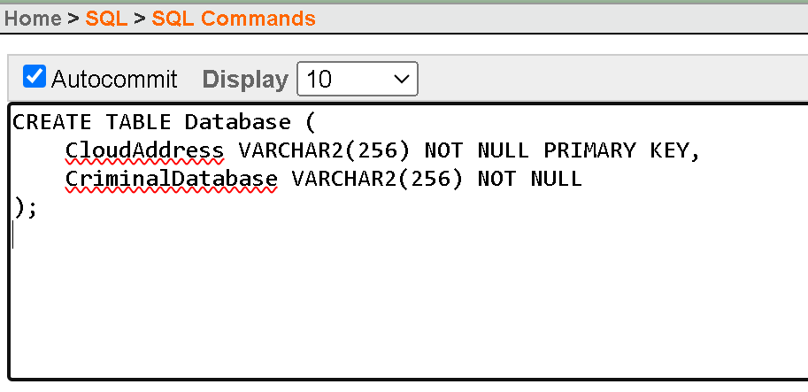
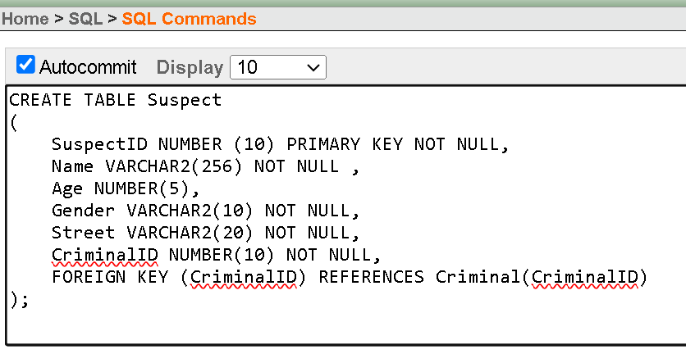
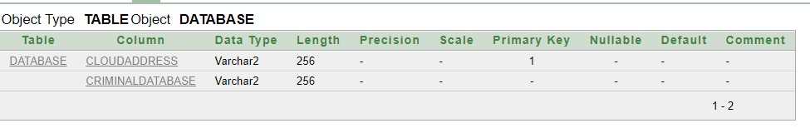
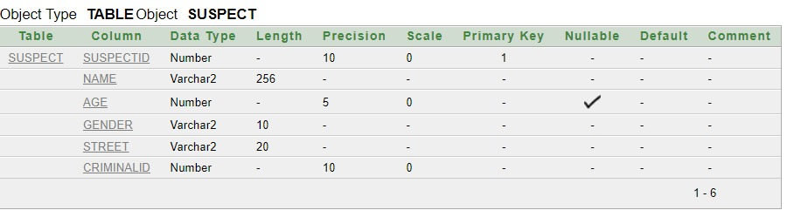
TABLE 3:
TABLE 4:
DESCRIPTION:
DESCRIPTION:

Slide 9
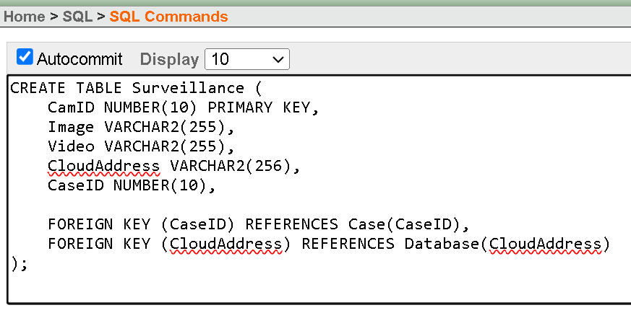
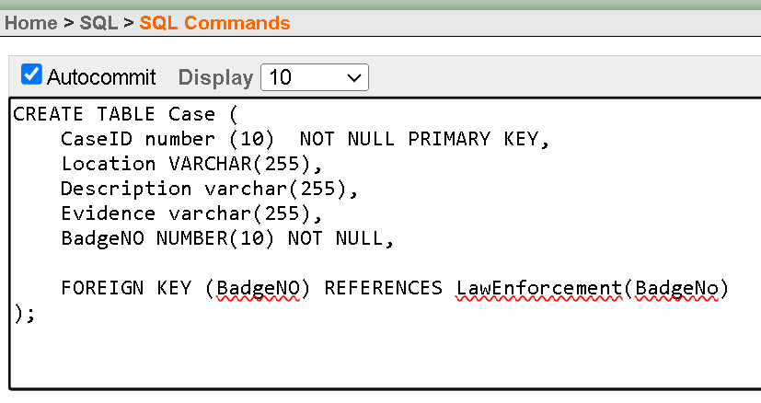
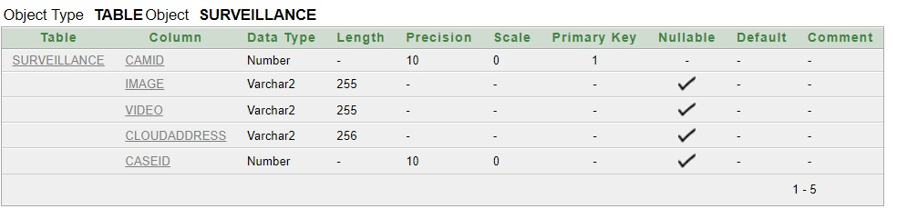
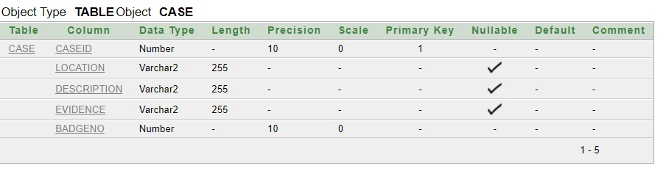
TABLE 5:
TABLE 6:
DESCRIPTION:
DESCRIPTION:

Slide 10
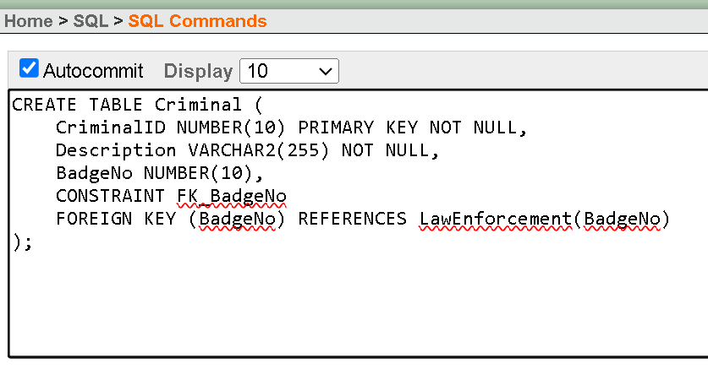
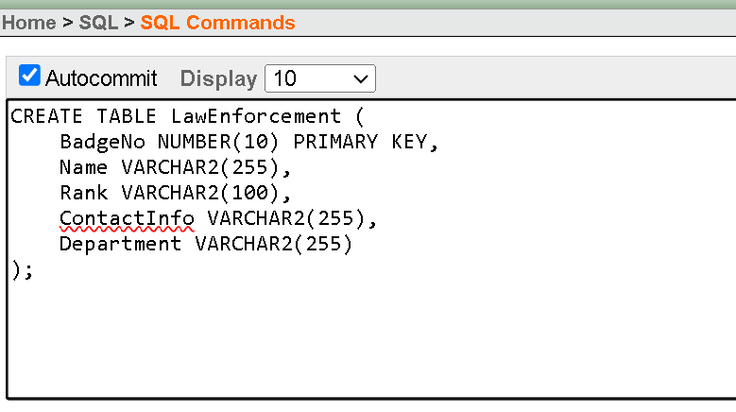
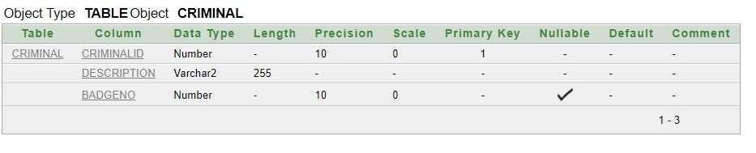
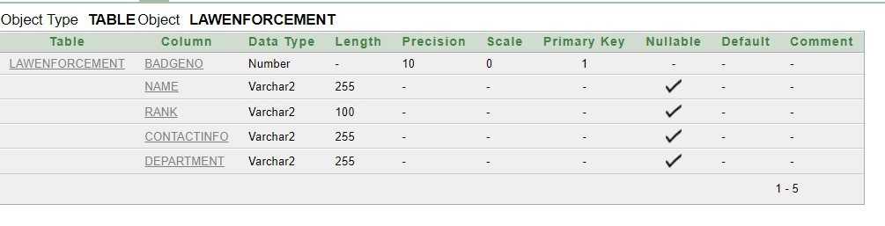
TABLE 7:
TABLE 8:
DESCRIPTION:
DESCRIPTION:

Slide 11
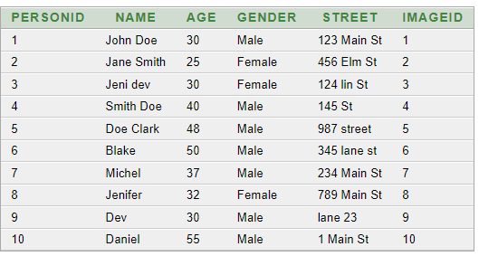
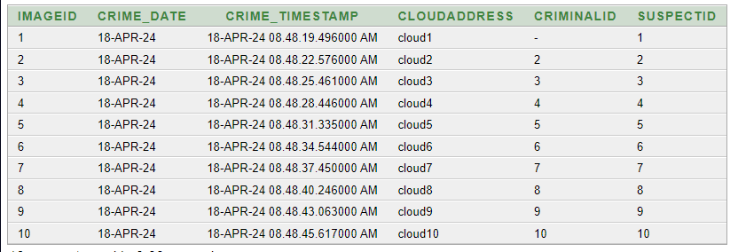
Inserted Values in the tables
Personinfo Table:
ImageDetection Table:

Slide 12
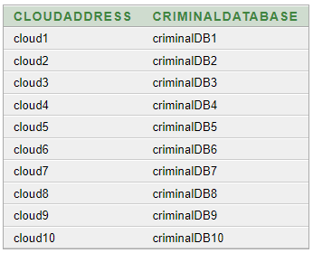
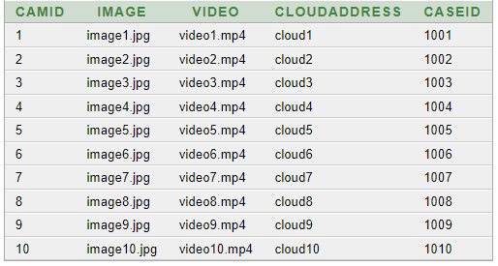
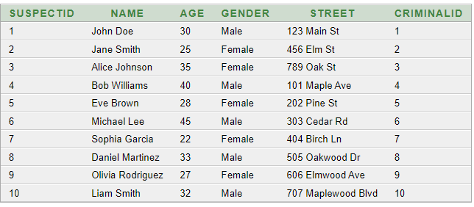
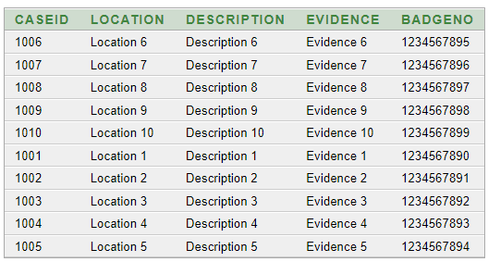
Database Table:
Surveillance Table:
Suspect Table:
Case Table:

Slide 13
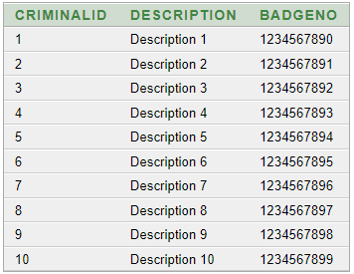
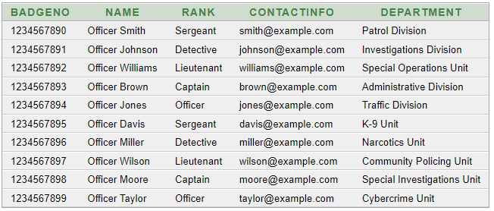
Criminal Table:
LawEnforcement Table:

Slide 14

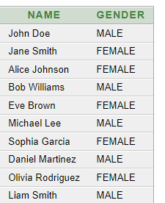
Query Test in DB
SIMPLE QUERIES
SELECT * FROM PersonInfo WHERE Gender = 'Male';
SELECT * FROM PersonInfo WHERE Age > 10;
SELECT * FROM PersonInfo WHERE Street = '145 st';
SELECT * FROM PersonInfo WHERE PersonID = 1;
Query with a single row function
SELECT LOWER(Image) AS Lowercase_Image FROM Surveillance;
SELECT Name, UPPER(Gender) AS Gender FROM Suspect;

Slide 15


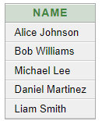
Query with a Multiple row function/ aggregate function
SELECT Gender, COUNT(*) AS Gender_Count FROM PersonInfo GROUP BY Gender;
SELECT MAX(Age) AS Max_Age, MIN(Age) AS Min_Age FROM PersonInfo;
Single row subquery and multiple row subquery
SELECT Name, Age FROM PersonInfo WHERE Age = (SELECT MAX(Age) FROM PersonInfo);
SELECT Name, Age FROM PersonInfo WHERE Age = (SELECT MIN(Age) FROM PersonInfo);
SELECT Name FROM Suspect WHERE SuspectID IN (SELECT SuspectID FROM ImageDetection);
SELECT Name FROM Suspect WHERE Age > (SELECT AVG(Age) FROM Suspect);

Slide 16
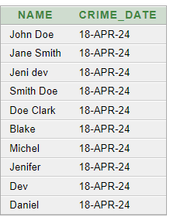
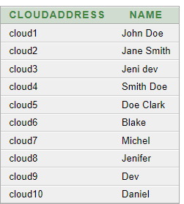
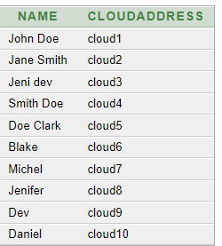
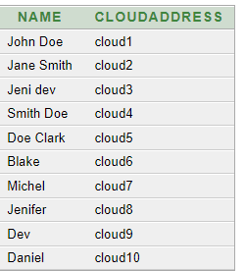
INNER JOIN
SELECT PersonInfo.Name, ImageDetection.Crime_Date FROM PersonInfo INNER JOIN ImageDetection ON PersonInfo.ImageID = ImageDetection.ImageID;
Kinds of Joining
RIGHT JOIN
SELECT ImageDetection.CloudAddress, PersonInfo.Name FROM PersonInfo RIGHT JOIN ImageDetection ON PersonInfo.ImageID = ImageDetection.ImageID;
LEFT JOIN
SELECT PersonInfo.Name, ImageDetection.CloudAddress FROM PersonInfo LEFT JOIN ImageDetection ON PersonInfo.ImageID = ImageDetection.ImageID;
FULL OUTER JOIN
SELECT PersonInfo.Name, ImageDetection.CloudAddress FROM PersonInfo
FULL OUTER JOIN ImageDetection ON PersonInfo.ImageID = ImageDetection.ImageID;

Slide 17
Simple view
CREATE VIEW PersonDetails AS SELECT PersonID, Name, Age, Gender FROM PersonInfo;
Complex view
CREATE VIEW SurveillanceDetails AS
SELECT Surveillance.CamID, Surveillance.Image, Surveillance.Video, ImageDetection.Crime_Date, ImageDetection.CloudAddress
FROM Surveillance
INNER JOIN ImageDetection ON Surveillance.CloudAddress = ImageDetection.CloudAddress;

Slide 18
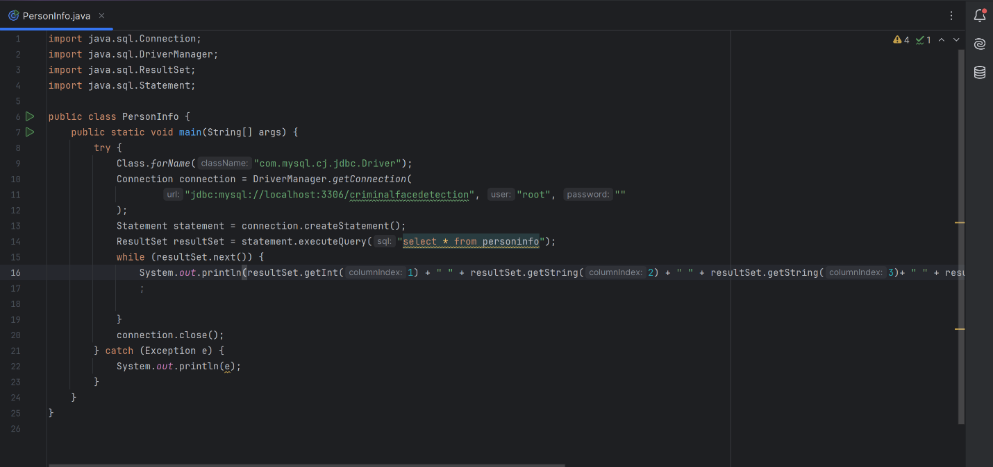
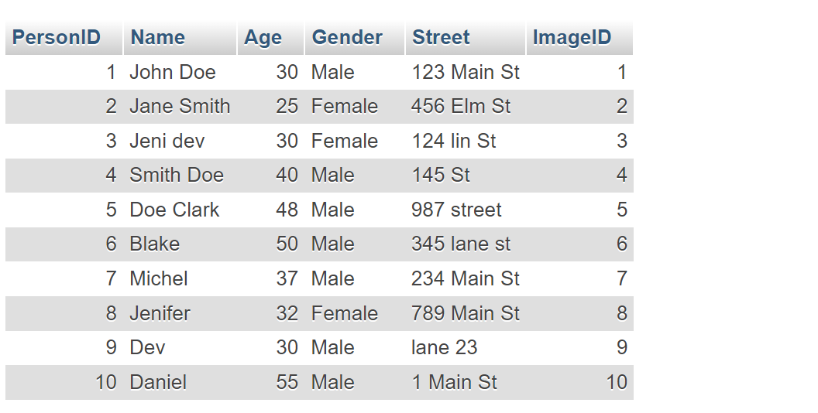
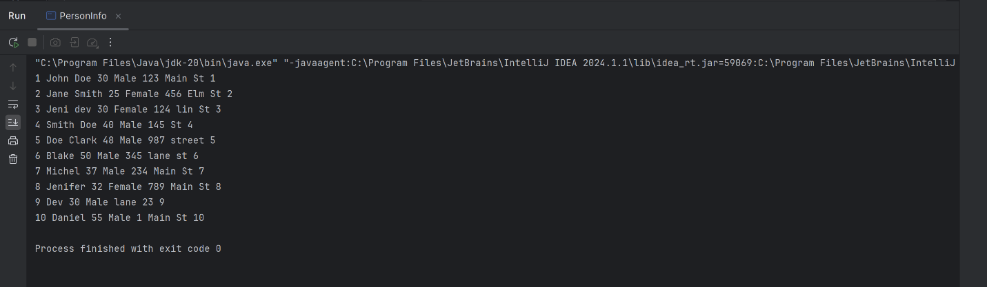
Description of a Successful DB connection
Connection Code:
1. Personinfo Table:
Output:

Slide 19
Conclusion
The criminal face detection database management system, utilizing Oracle 10g and Canva, offers a groundbreaking advancement in security technology. By employing image recognition, it automates background checks, streamlining identification of individuals with criminal histories. This innovation eliminates errors and manipulation inherent in manual methods, enhancing security efficiency. Targeting security forces primarily, it promises a more effective approach to identifying threats. Secondary consumers like financial institutions and educational establishments benefit from improved security, preventing fraud and ensuring safety. Future prospects include refining algorithms, integrating more security features, and expanding into other sectors. Ultimately, the project signifies a significant leap forward in global security enhancement.

Slide 20

THANK YOU EVERYONE

